Slide 1



Predicting Customer Churn for a Telecom Company Using Machine Learning
This project builds a ML model to predict customer churn, enabling data-driven strategies to improve retention and optimize business performance.

Slide 2
Objective
1
Objective
2
Goal
3
Key Challenge
Build a machine learning model to predict whether a customer will leave a telecom company (customer churn).
Utilize data-driven insights to improve customer retention and optimize business strategies.
Preventing customer churn by predicting it in advance using historical data and machine learning.

Slide 3


Understanding Customer Churn
1
What is Churn?
Customer churn refers to the loss of clients who stop using a service or product, significantly impacting revenue and growth.
2
Churn Rate
Churn rate is the percentage of customers who discontinue their service during a specific time period. The formula for churn rate is: Churn Rate = (Number of Customers Lost / Total Customers at the Start of the Period) x 100
3
Importance of Churn Prediction
Predicting churn enables targeted retention strategies, revenue preservation, and improved customer insights.

Slide 4
Importance of Churn Prediction
1
Customer Retention
2
Revenue Preservation
3
Improved Customer Insights
Identify at-risk customers to implement targeted retention strategies.
Reduce churn to save on customer acquisition costs.
Understand churn to improve products and services.
4
Competitive Advantage
Effective churn prediction leads to long-term success.

Slide 5
Churn Prediction Use Cases
Telecom Industry
Subscription Services
Banking
Identifying customers likely to switch providers, enabling retention offers.
Personalizing marketing efforts for at-risk customers to enhance engagement.
Offering personalized financial advice or products to retain customers.

Slide 6

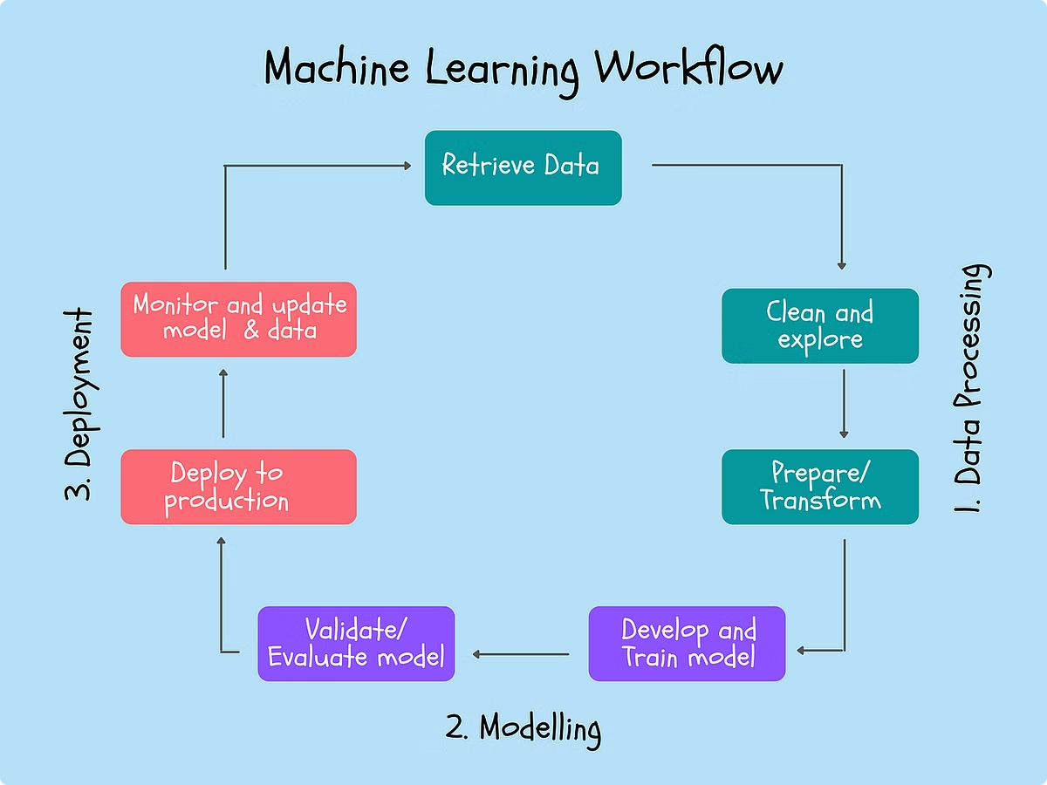
Project Workflow
1
Data Collection
Gather customer data, including usage, plans, and demographics.
2
Data Cleaning
Clean and prepare data to handle missing values and inconsistencies.
3
Data Preprocessing
Prepare data for modeling, handling missing values and inconsistencies.
4
Data Storage
Store cleaned data in MySQL for processing.
5
Model Building
Build churn prediction model using Random Forest.

Slide 7

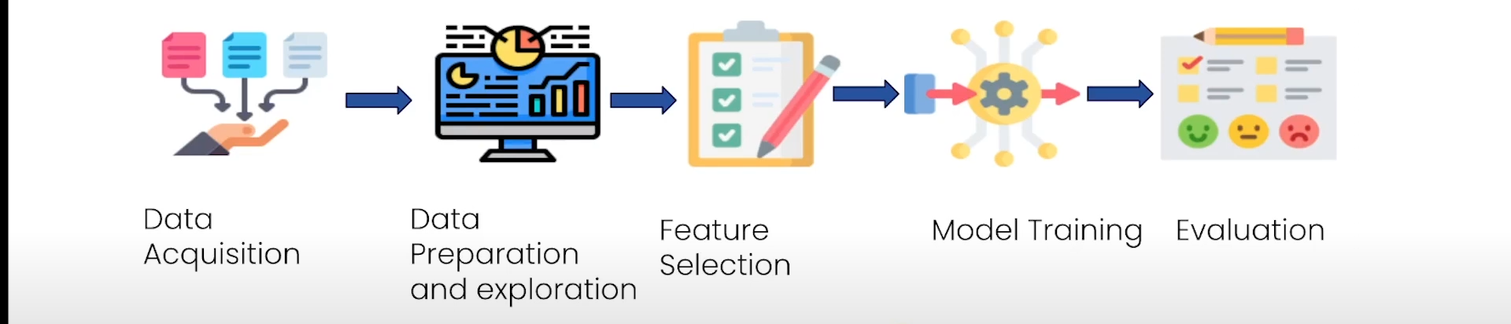
Deployment and Testing
Deployment
Deploy the model in a user-friendly web application, containerize with Docker, and orchestrate with Kubernetes.
Testing
Implement Pytest to validate the model and pipeline, ensuring reliable performance.
Automation
Use Jenkins to automate the deployment and model updates through CI/CD.

Slide 8





Tools and Technologies
MySQL
For data storage and management.
Python
For data processing, EDA, and machine learning.
Docker
To containerize the application.
Kubernetes
For container orchestration and scaling.

Slide 9




Project Status (Complete)
Data Collection & Preprocessing
Complete
Model Training
Complete
Unit Testing
Complete
Web App Development
Complete

Slide 10

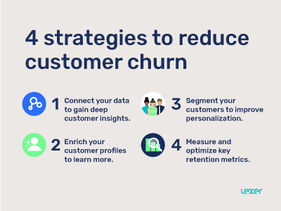
Expected Outcome
1
Predict Customer Churn
2
Improve Customer Retention
3
Optimize Business Performance
Successfully predict whether a customer will leave the telecom company.
Enable the telecom company to implement targeted strategies to retain more customers.
Leverage data-driven insights to enhance overall business strategies and profitability.

Slide 11
My Contribution
Exploratory Data Analysis
Payment Analysis & Insights
Model Training
Support Vector Machine, Decision Tree
Model Evaluation
AUC-ROC Curve
Unit Testing
Pytest

Slide 12
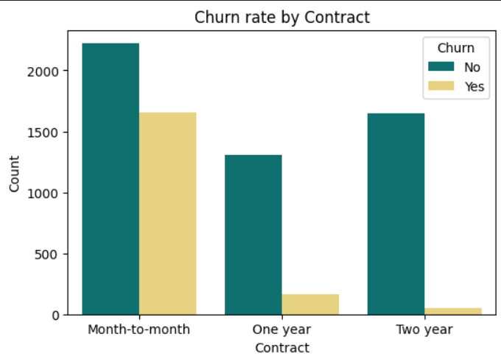
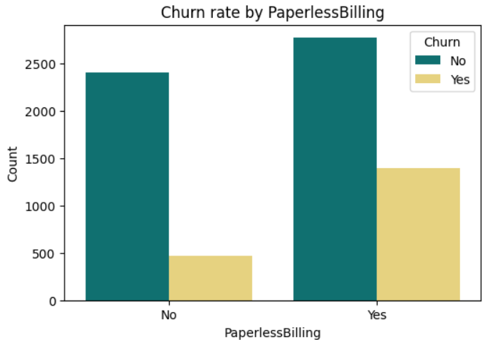
Exploratory Data Analysis
The shorter the contract, the higher the churn rate.
Churn Rate is higher for the customers who opted for paperless billing.

Slide 13
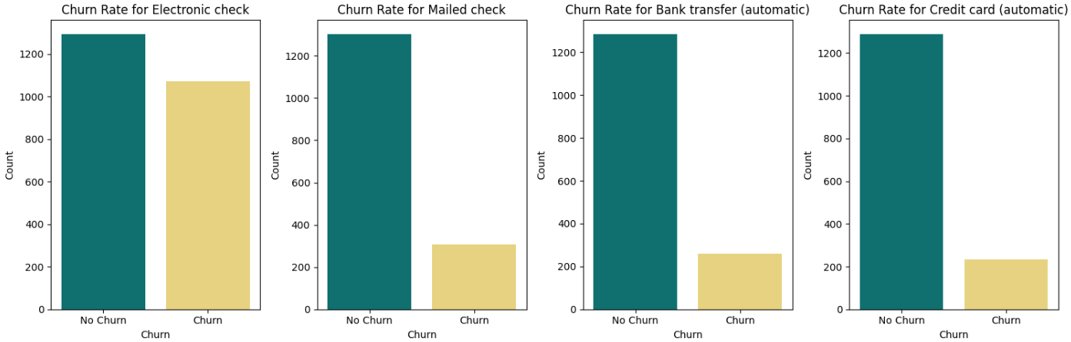
Exploratory Data Analysis
Customers who pay with electronic checks are more likely to churn, and this kind of payment is more common than other payment types.

Slide 14
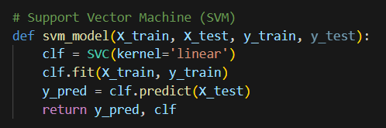
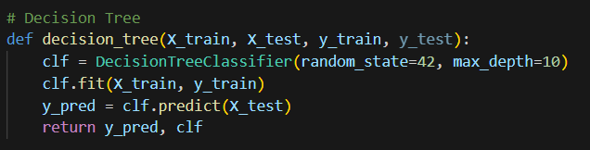
Machine Learning Model (Code)

Slide 15
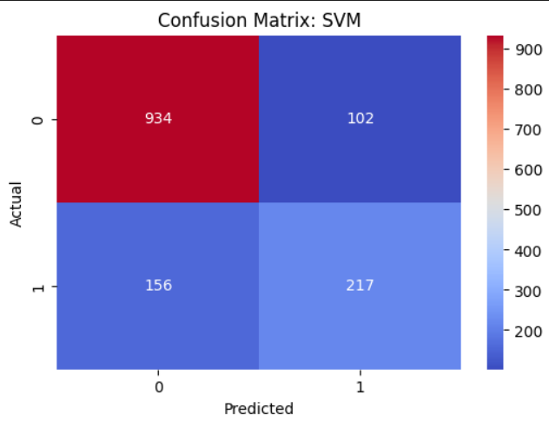
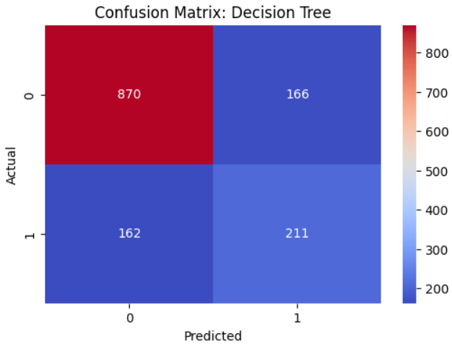
Machine Learning (Confusion Matrix)

Slide 16
Machine Learning (Model Evaluation)
Model | Accuracy | Precision | Recall | F1-Score
Support Vector Machine | 81.7% | 68% | 58.2% | 62.72%
Decision Tree | 76.72% | 55.92% | 56.56% | 56.26%

Slide 17
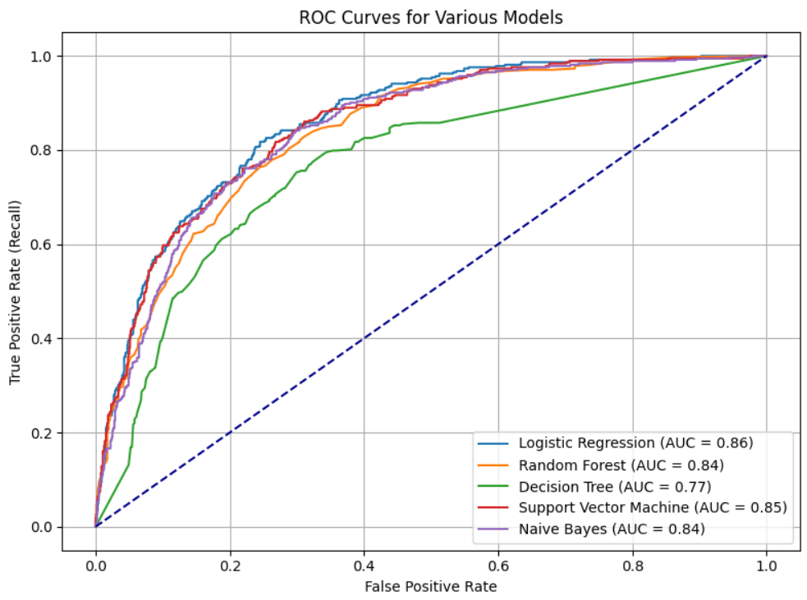
Machine Learning (AUC-ROC)
The Logistic Regression curve is consistently better at distinguishing between classes compared to the other models.
SVM is a close competitor to Logistic Regression. Decision Tree is the worst-performing model, with a noticeable dip and an AUC of 0.77, indicating a lower ability to classify positives correctly.
Random Forest and Naive Bayes show comparable performance, with identical AUC scores of 0.84.

Slide 18
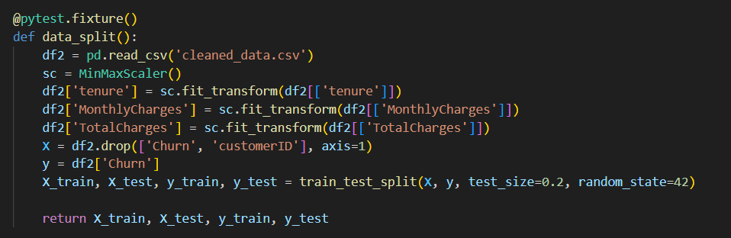
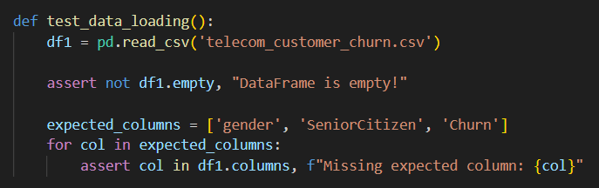
Unit Testing (Codes)

Slide 19
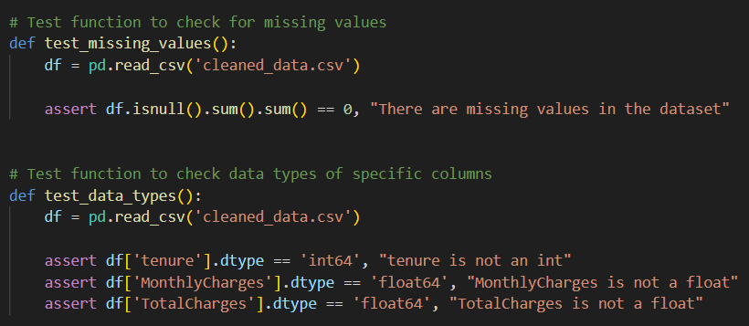
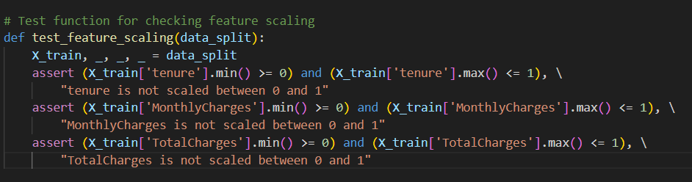
Unit Testing (Codes)

Slide 20
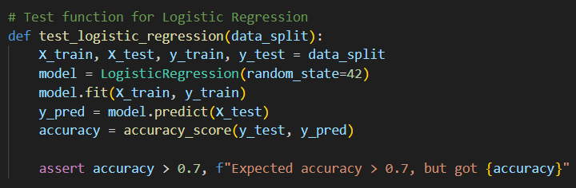
Unit Testing (Codes)

Slide 21
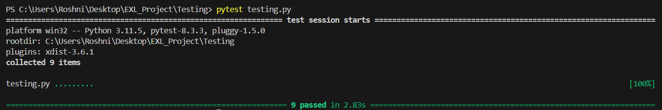
Unit Testing (Result)
All 9 test cases passed

Slide 22
Thankyou

